Slide 1
Enhanced DADA Model for Polyps Detection
ICS 590: Spl Topics in Deep Learning
Student: Dalal Aldowaihi g202514270
Supervisor: Dr. Muzammil Behzad

Slide 2

Outline
Introduction
Literature Review
Limitations
Baseline Model and Challenges
Proposed Enhancements
Datasets and Preprocessing
Experiment Setup
Loss Function and Optimization
Performance Metrics
Results
Conclusion

Slide 3
Introduction
Colorectal cancer prevention relies on accurate polyp detection.
However, detectors suffer from high false-positive rates.
Background patterns (folds, shadows, highlights) often mimic polyps.
Existing augmentation methods mostly generate positive samples, not challenging negatives.

Slide 4
Literature Review
Existing Approaches
GAN-based synthetic polyp generation (pix2pix, DS-GAN, ControlPolypNet) → focus on generating positive samples
Adversarial attacks for robustness (APGD, FAB).
Inpainting models (Repaint, LaMa).
Gaps in Literature
Most methods ignore negative samples.
No prior work on targeted false-positive synthesis.
Limited realism and poor control over generated patterns.

Slide 5
Limitations
Only enhances polyp variety, not background variability. → complex colon environment
High dependency on polyp masks/annotations.
Synthetic positives cannot reduce false alarm behaviours which increases the workload of clinicians and diagnose mistake
Inpainting and attack methods fail to produce meaningful high-value negatives.

Slide 6
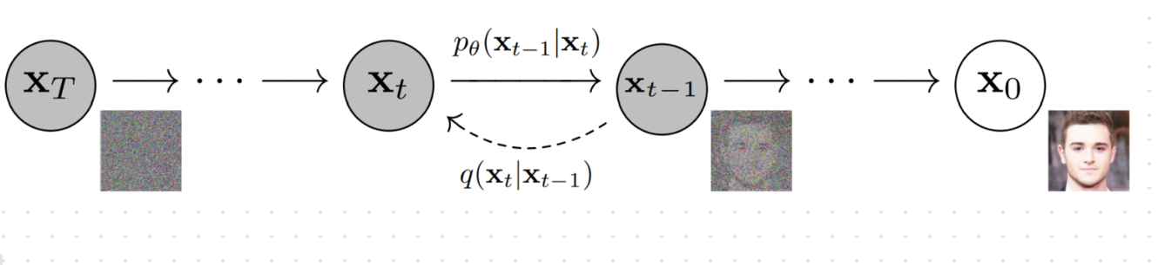
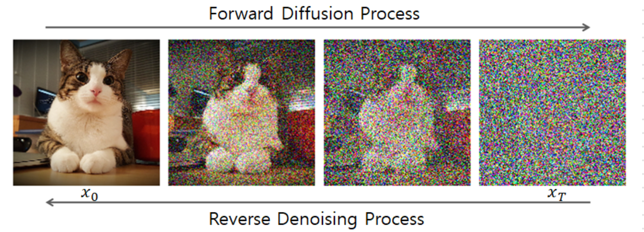
Denoising Diffusion Probabilistic Models (DDPM)
Denoising Diffusion Probabilistic Models (DDPM) are a class of generative models that use the diffusion process to model the noise in the images.
Enhance object detection by generating challenging, high-value training data

Slide 7
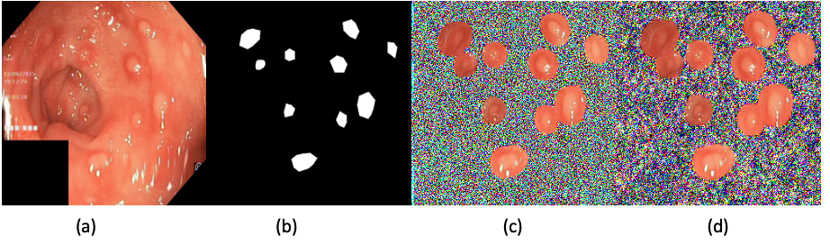
Background-only DDPM as the base negative generator
A background-only DDPM is a diffusion model that is trained only on the background portions of colonoscopy images — not on polyps.
During training, all polyp regions are masked out, so the model never learns their shapes, textures, or boundaries.
Because of this, the model learns to generate pure negative samples:
Clean colon tissue
Folds
Lumen edges
Specular highlights

Slide 8
Baseline Model and Challenges
DADA Framework
  Background-Only Diffusion Model (BG-De) is (DDPM) → Background-only Denoiser as Base Negative Generator using Regional Noise Matching
  Detector-Guided Adversarial Perturbation (DADA)
  Localized Inpainting for realistic context
Baselines
  background-only DDPM
  YOLOv5
  DETR (Transformer-based detector)
Goal
  Generate false-positive–inducing patterns that teach detectors what not to detect. → Polyp-like artifacts confuse detectors.
  To improve robustness.

Slide 9
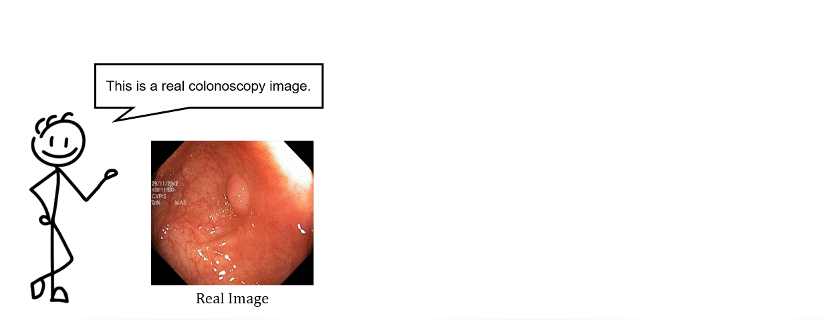
DADA Framework

Slide 10
Core idea behind BG-De + DADA:
Real image → select polyp region
1
Create mask → define editable region
2
Replace background with random noise → Polyp region kept
3
BG-De will reconstruct the background → diffusion model removes noise and restores background texture.
4
Perturbations will push the polyp-like region→ The white region (the mask) becomes a synthetic false-positive pattern + The rest becomes realistic background
5

Slide 11
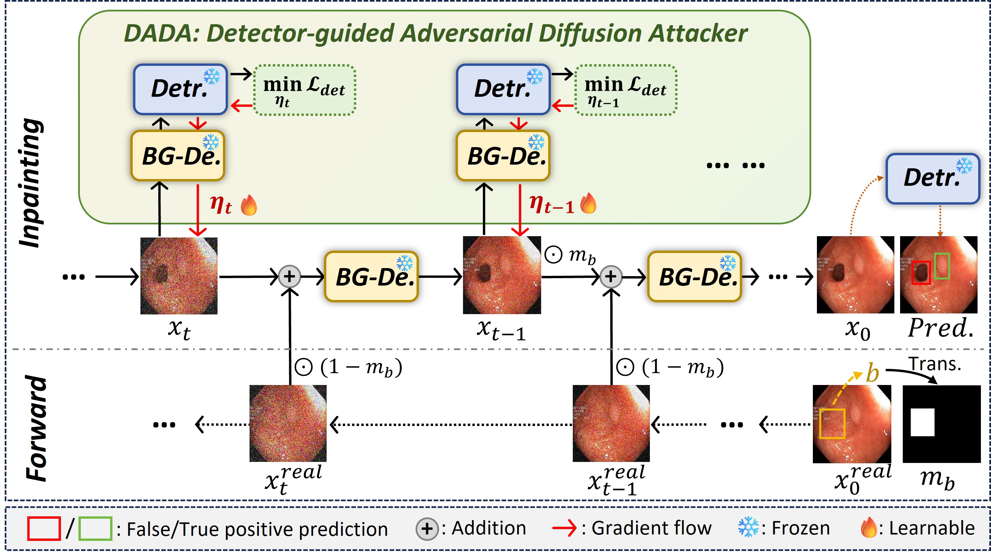

Slide 12
Proposed Enhancements
Refine the region-adaptive loss function and Tissue-Consistency Loss
Adapt the perturbation factor α across anatomical regions, applying stronger perturbations in areas prone to false positives.
Apply OneCycleLR Scheduler for stable training and improve convergence.
Evaluate the performance of the proposed enhancements through experiments on the Kvasir and ETIS-Larib Polyp DB.

Slide 13
Datasets and Preprocessing
Datasets
Kvasir: 1000 polyp images
ETIS-Larib: dataset is a set of 196 high-resolution colonoscopy polyp images
Preprocessing
Kvasir → Resize to 256 × 256
ETIS-Larib → Resize to 512 × 512
bounding boxes generated from masks.
Split 8:1:1

Slide 14
Experiment Setup
NVIDIA A100 GPU and trained for 100 epochs.
YOLO trained using official default settings.
Two-fold training:
  Train BG-De on Fold A → augment Fold B
  Train BG-De on Fold B → augment Fold A
BG-De inference:
  1000 denoising steps
  α = 0.003

Slide 15
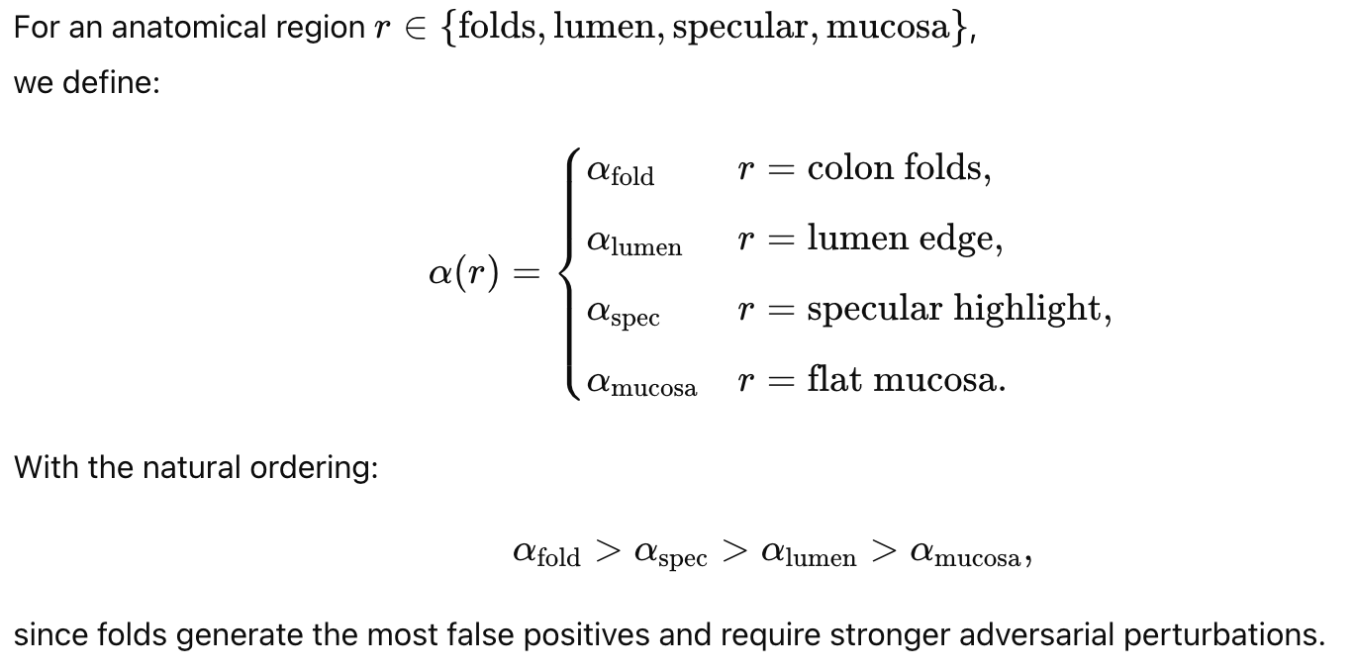
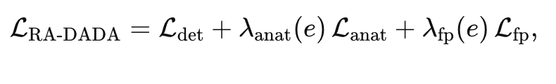
Loss Function
  Region-adaptive DADA loss function
    YOLO/DETR detection loss
    False-Positive Generation Loss
    Anatomical Consistency Loss

Slide 16
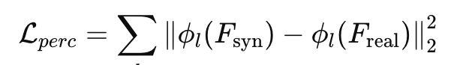
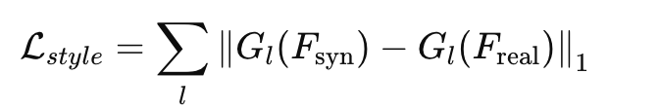
Loss Function
Tissue-Consistency Loss to ensure that the synthetic region generated by the diffusion model remains anatomically realistic.
  Perceptual Loss (Feature Similarity) : This measures how similar the synthetic patch is to real colon tissue.
  Style Loss (Gram-Matrix Matching): This matches the style statistics (correlations between feature channels) of real tissue.
By combining both losses, the model prevents unrealistic distortions and maintains anatomical fidelity, even while applying adversarial perturbations to generate false positives.

Slide 17
Adapt the Perturbation Factor
Region | Why | α value
Specular highlights | confusing texture → high FP | high α
Mucosal folds | irregular shape → FP | medium α
Smooth background tissue | stable | low α
Polyp region | should not distort too much | very low α
Use different α values for different anatomical regions.
Because some regions cause more false positives than others.
If you give stronger perturbations to confusing regions, the diffusion model learns to generate stronger hard negatives.

Slide 18
OneCycleLR Scheduler
Starts with a low learning rate
Increases it gradually to a maximum value
Then decreases it back to a very small value
Optionally also adjusts momentum in the opposite direction
This “cycle” happens within one full training run, not multiple epochs.
OneCycleLR helps:
  Stabilize adversarial diffusion training
  Prevent exploding gradients in early epochs
  Improve convergence when using region-adaptive losses
  Speed up training when you cannot afford 200k–300k diffusion steps

Slide 19
Performance Metrics
DDADA aims to increase precision by reducing false positives.
etector-Level Metrics (YOLOv5 Evaluation)
  Precision (P)
  Recall (R)
  F1 Score
Generation-Level Metrics (Quality of Generated Samples)
  False Positive Score (FPS)
  Confidence of the Detector
  Realism of Generated Negatives

Slide 20
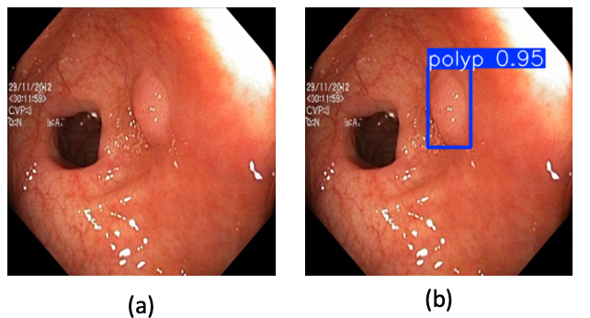
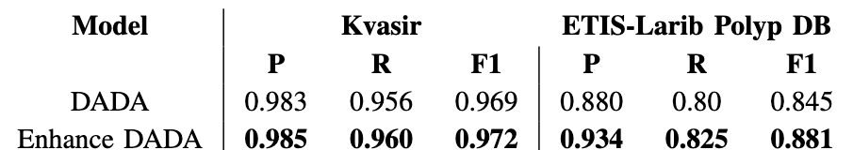
Result
Increase in detection confidence → making predictions more reliable
Key Observation
  When use different α values for different anatomical regions to generates difficult background samples based on → dramatically reduces false positives.

Slide 21
Conclusion
DADA introduces a novel Framework: synthetic false-positive generation.
Combines diffusion models + adversarial attacks + inpainting.
Produces high-value negative samples that improve detector precision.
Opens new direction for robust medical AI.
limitation
  For the optimal result of DDPM requires close to 200k iterations, which means the diffusion-based training often ranges from 50,000–300,000 steps, computational demands that require high-end GPUs.
  In DADA framework BG-De trained for 320k iterations on 2× RTX 4090

